Slide 1
Medicare-For-All
Senate status and next steps
Eagan Kemp
Health Care Policy Advocate
Public Citizen

Slide 2
Senate Medicare-for-All rollout
Senator Sanders introduced S. 1804 on Sept. 13 with 16 original co-sponsors to a standing room only/overflow crowd
Twitter: Bernie Sanders and #MedicareForAll were the top trending topics in DC throughout much of the day and week
Coalition thunderclap reached nearly 600,000 people
Extensive media coverage – more positive and more detailed than expected
Support for single-payer continues to rise in public opinion polls

Slide 3
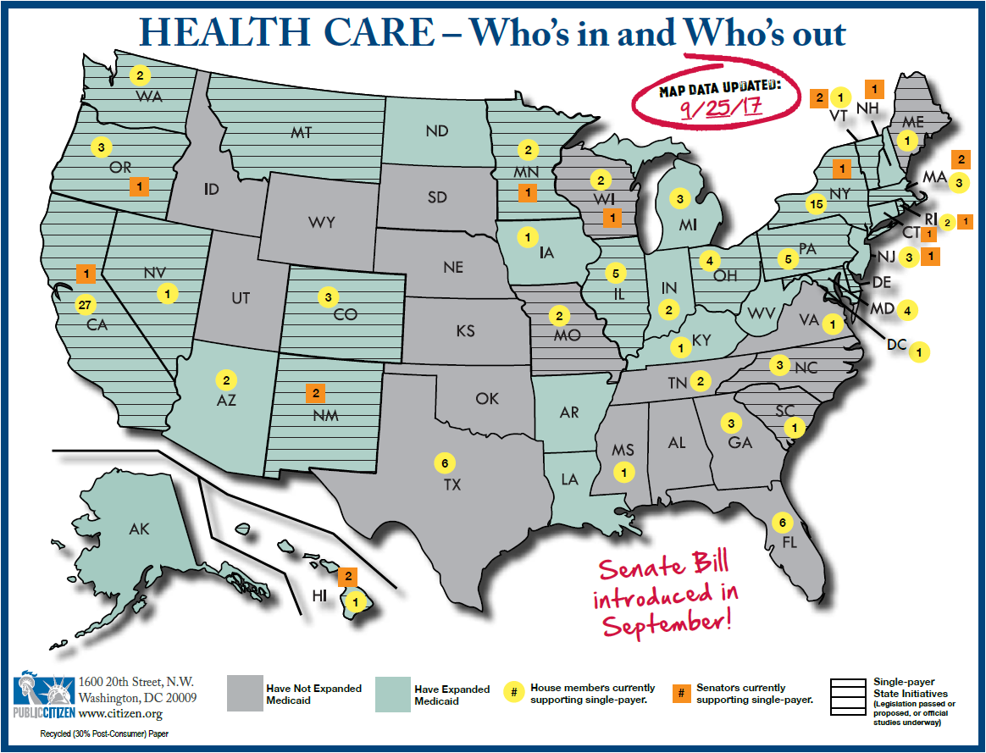

Slide 4
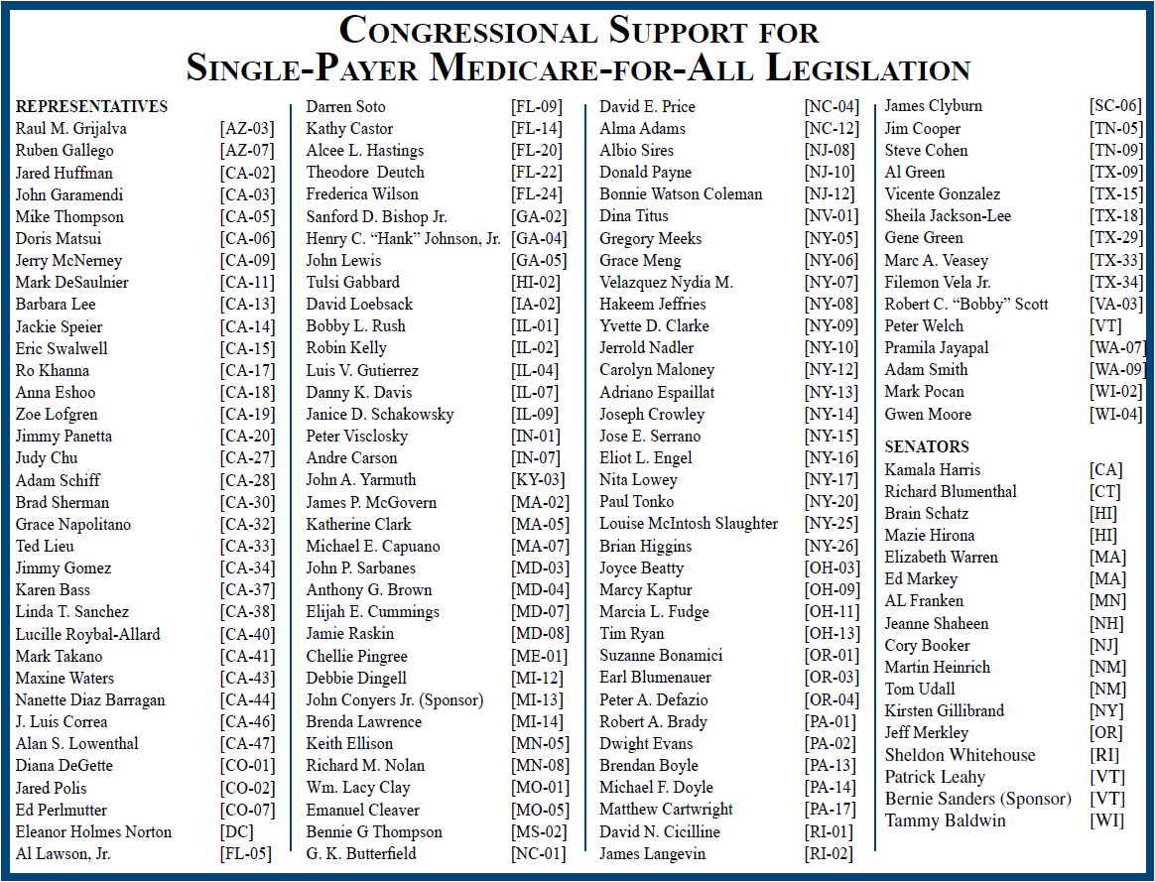

Slide 5
Public polling
Most recent: Favor 52% versus oppose 48%
(Dem: 69/31; Rep: 35/65; Ind: 49/51)
Do you favor or oppose so-called single-payer healthcare plans in which the government collects taxes and pays for all healthcare and private health insurers are eliminated?
Harvard-Harris poll – Sept. 2017

Slide 6
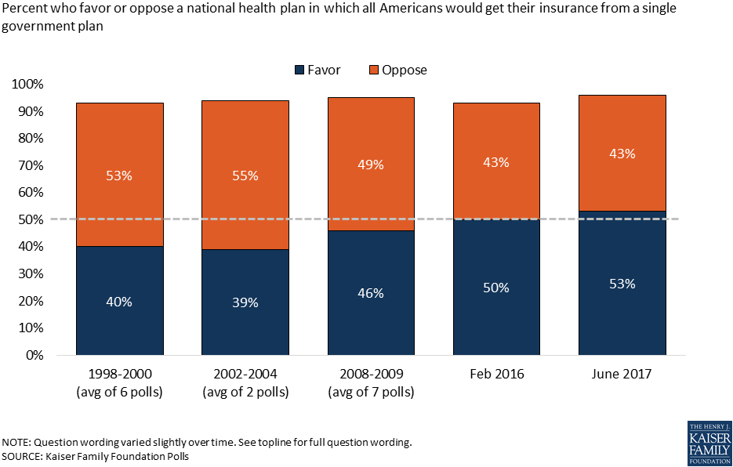

Slide 7
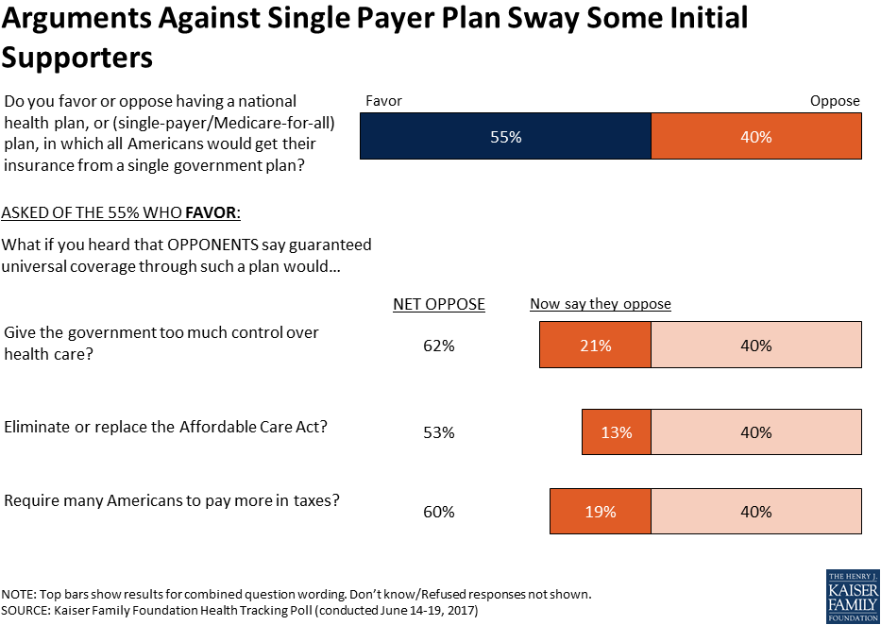

Slide 8
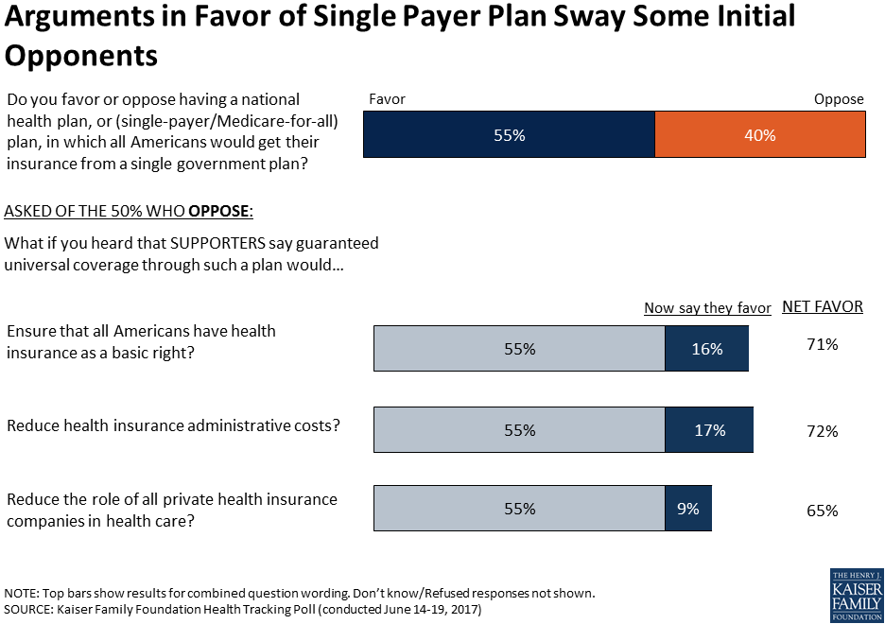

Slide 9
What’s driving changes in public opinion?
Around 30 million Americans remain uninsured
Uninsured rate rising
ACA repeal fight
Medicare-for-All legislative action
Grassroots efforts
Rising Costs and narrowing networks

Slide 10
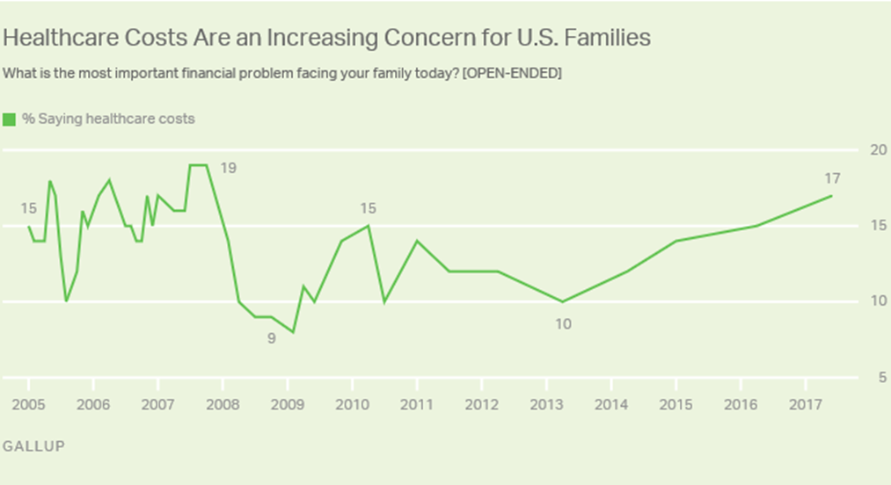

Slide 11
Questions or comments?
Contact info:
ekemp@citizen.org
202-454-5109 or 435-770-9924

